Slide 1


S-Risk® - Advanced demo
Health

Slide 2
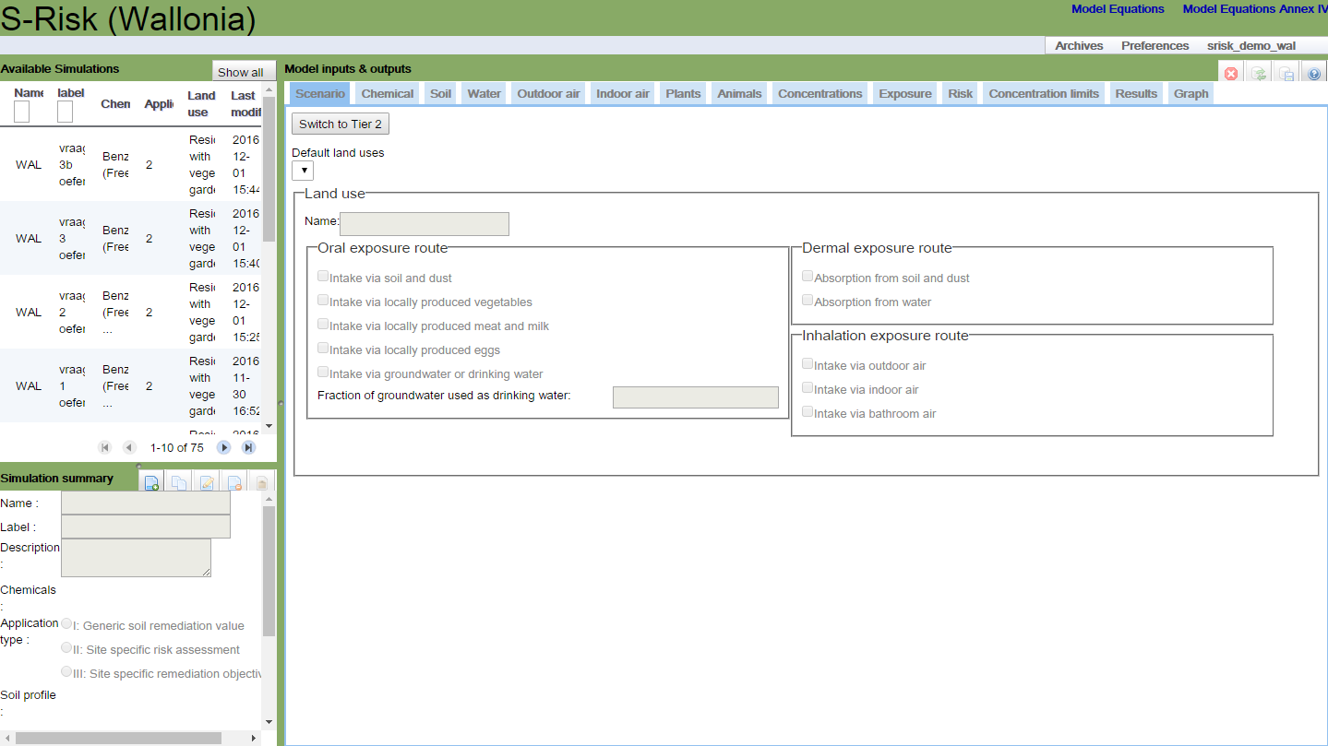
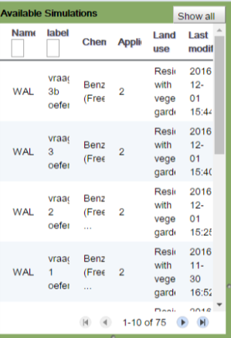
Application features
Simulations of colleagues within the same company
Read-only
“Buddy” simulations can be cloned to your own account with the “Copy simulation” button

Slide 3
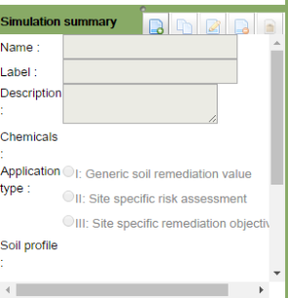
Application features

Slide 4
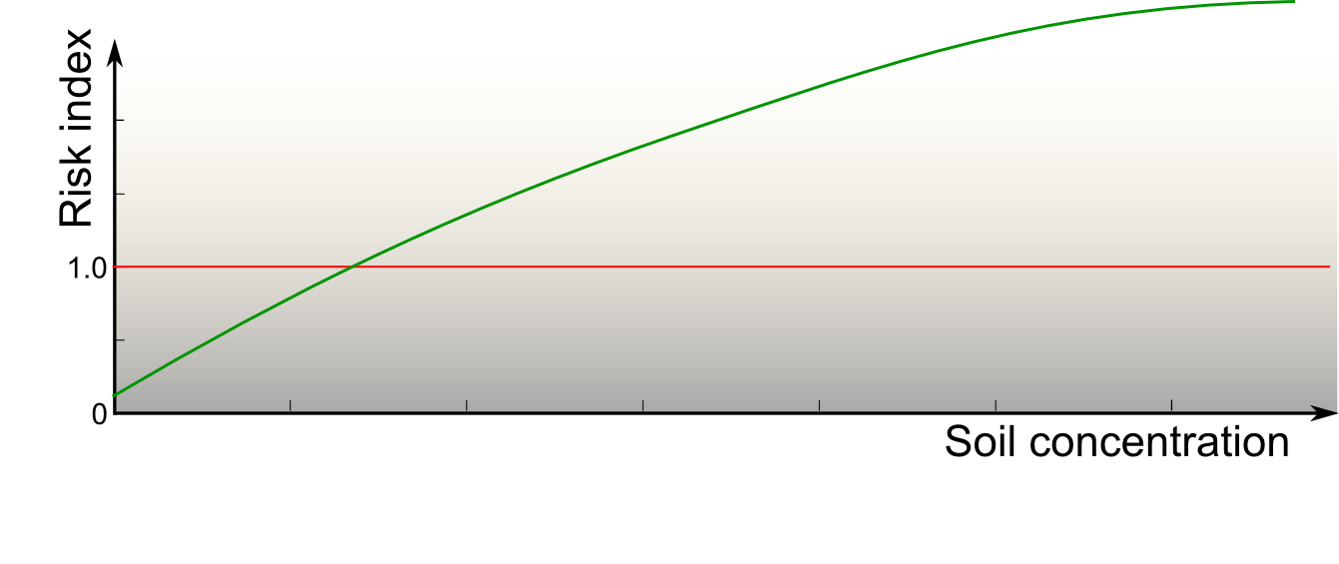
Application features
Three application types
Applications I & III
Application II
RI !
RI = 1
User
Input?
Critical soil
concentration!

Slide 5
Application features
TIER 1 / TIER 2:
Switch between compact and extended mode
Additional parameters become available
Some parameters become editable (comment mostly mandatory)

Slide 6
Application features
“Customize”:
For land use / chemical substance / soil layer
Modification of name mandatory
Determines if parameters are adaptable (also in other tabs)
Saving data in DB:
When switching between tabs
“Save” button at the top right
Justification:
Icon next to input fields/buttons
Useful explanation: user responsibility
Mandatory for a number of parameters

Slide 7
Conceptual site model
Residential area with benzene contamination
Application II – Tier 2 modus
Residential with vegetable garden
Risks: threshold & non-threshold effects (both systemic)
Adding benzene as a new (“blank”) chemical
Adding specific measurements
Layer 1 – standard sandy loam | 0 – 1.5 m
benzene | 0.5 mg/kg
Layer 2 – standard sand | 1.5 – 3 m
benzene | 1.2 mg/kg
Groundwater | 3m
benzene | 250 µg/l
Specific measurements of benzene in
vegetable garden | 0.9 mg/kg
indoor air (total) | 2.1E-3 mg/m³
http://www.s-risk.be

Slide 8
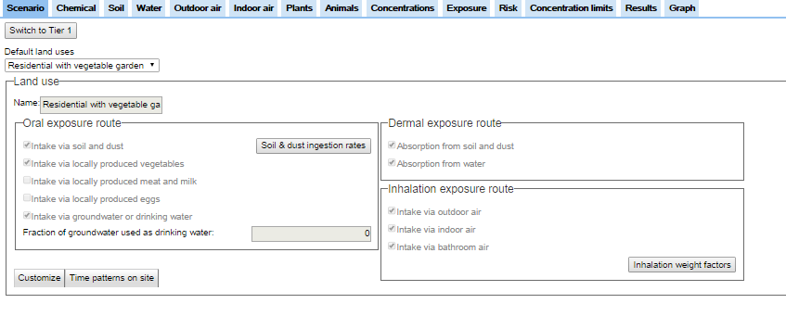
S-Risk web application
Residential area with benzene contamination – Scenario tab

Slide 9
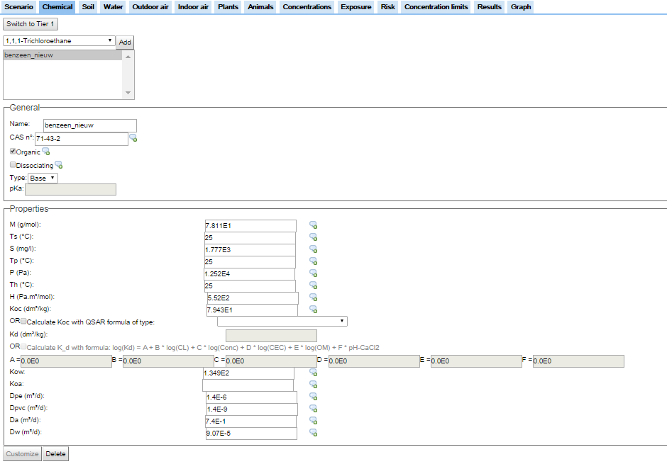
S-Risk web application
Modelconfiguratie – Chemical tab
Residential area with benzene contamination – Chemical tab

Slide 10
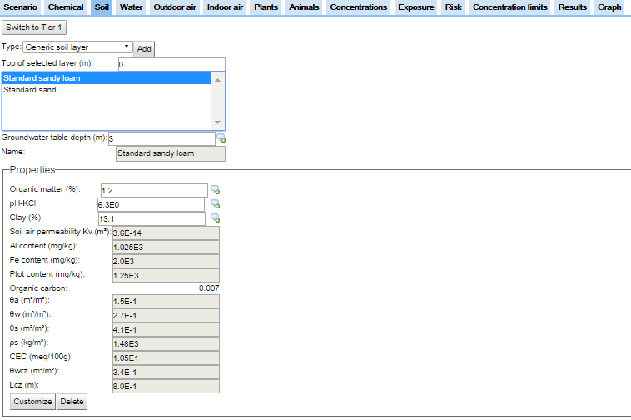
S-Risk web application
Modelconfiguratie – Soil tab
Residential area with benzene contamination – Soil tab

Slide 11
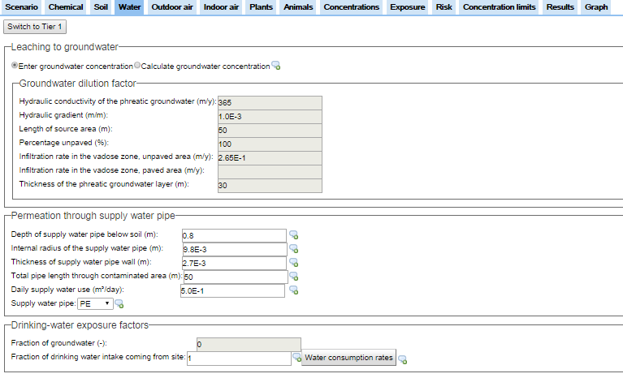
S-Risk web application
Modelconfiguratie – Water tab
Residential area with benzene contamination – Water tab

Slide 12
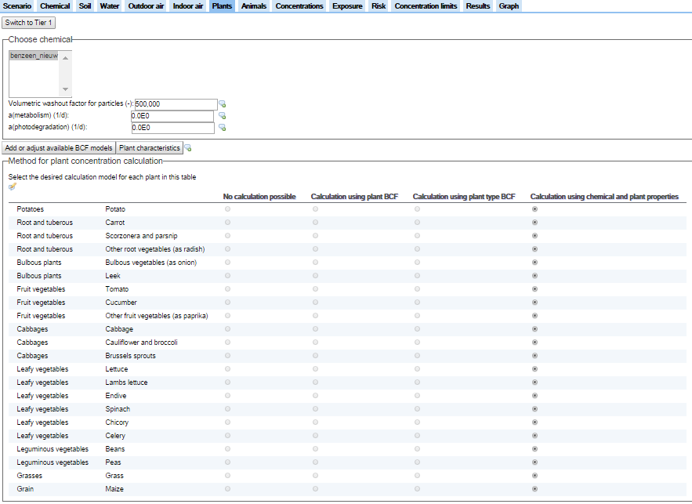
S-Risk web application
Modelconfiguratie – Plants tab
Residential area with benzene contamination – Plants tab

Slide 13
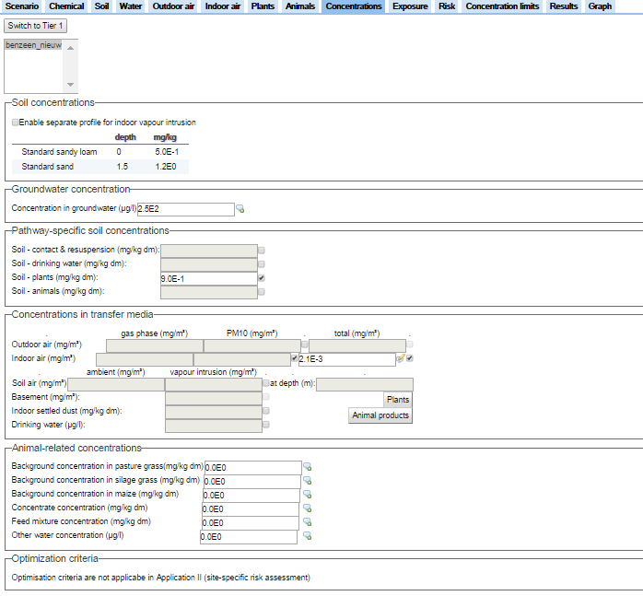
S-Risk web application
Modelconfiguratie – Concentrations tab
Residential area with benzene contamination – Concentrations tab

Slide 14
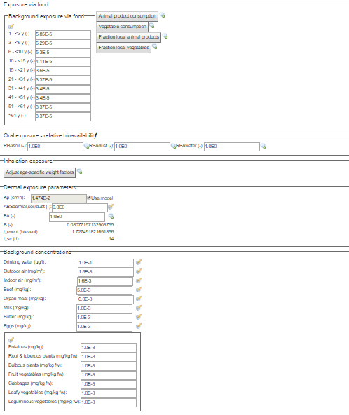
S-Risk web application
Residential area with benzene contamination – Exposure tab

Slide 15
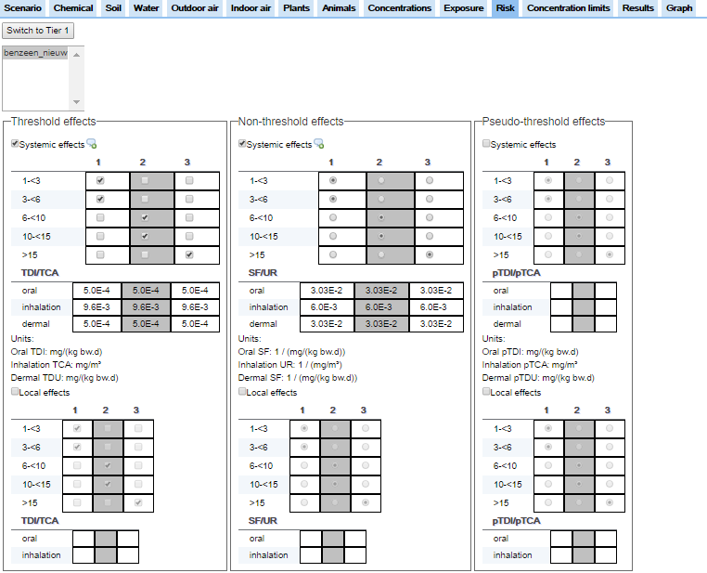
S-Risk web application
Modelconfiguratie – Risk tab
Residential area with benzene contamination – Risk tab

Slide 16
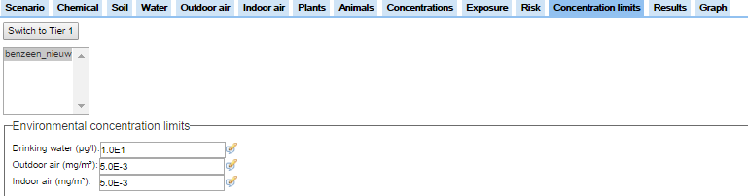
S-Risk web application
Residential area with benzene contamination – Concentration limits tab

Slide 17
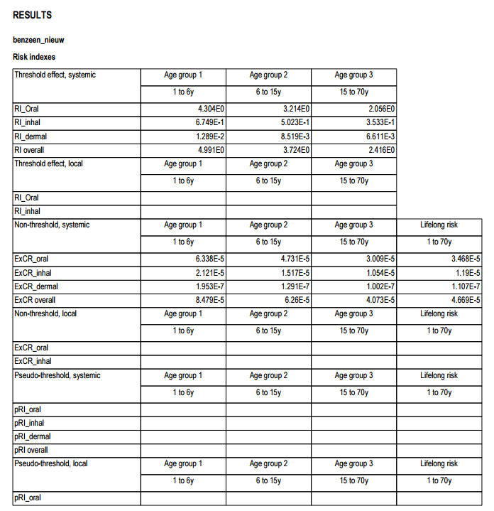
PDF Report
Modelconfiguratie – Results tab
Residential area with benzene contamination

Slide 18
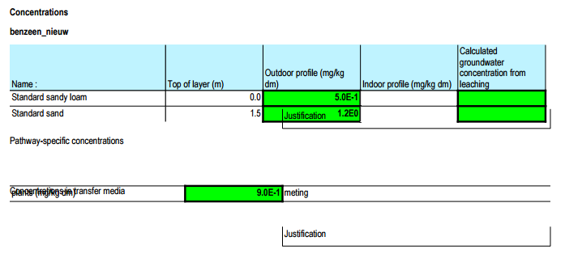
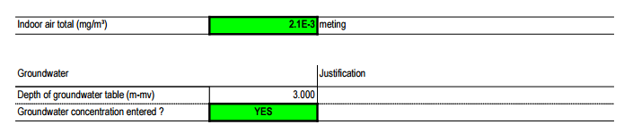
PDF Report
Modelconfiguratie – Results tab
Residential area with benzene contamination

Slide 19
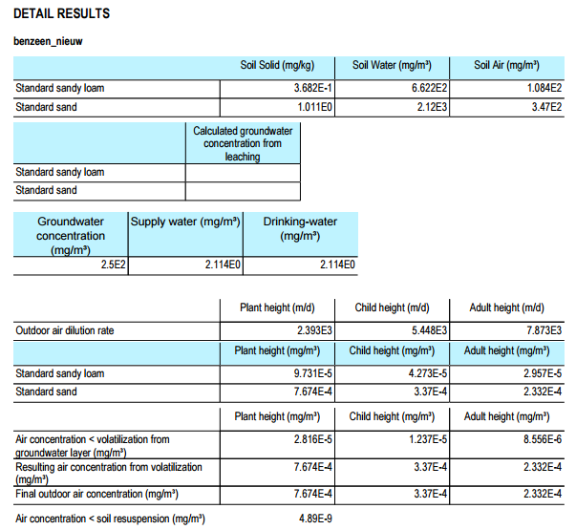
PDF Report
Modelconfiguratie – Results tab
Residential area with benzene contamination

Slide 20
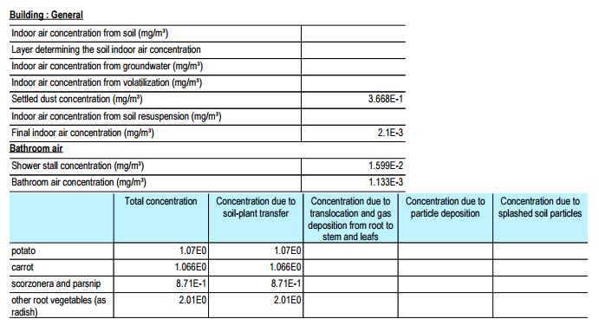
PDF Report
Modelconfiguratie – Results tab
Residential area with benzene contamination
No intermediate results due to entered indoor air concentration

Slide 21
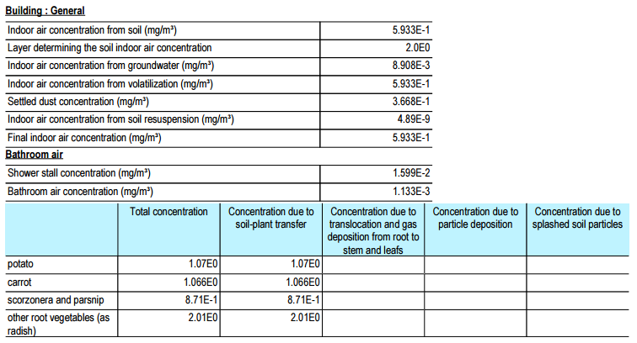
PDF Report
Modelconfiguratie – Results tab
Residential area with benzene contamination
Intermediate results due to calculated indoor air concentrations

Slide 22
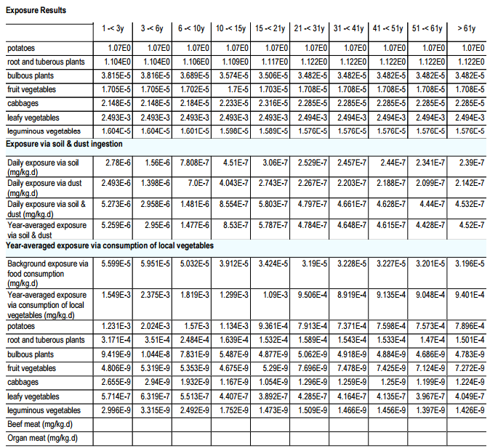
PDF Report
Modelconfiguratie – Results tab
Residential area with benzene contamination

