Slide 1


S-Risk® - web interface
Health

Slide 2
Content
S-Risk application & technical set-up
Web portal

Slide 3
S-Risk application & technical set-up
Why a web application?
No distribution problems
No installation problems – runs on any browser
Operating system & hardware independent
Always up-to-date
Central data storage & backup
Internet connection necessary
Less direct feedback of results

Slide 4



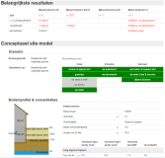



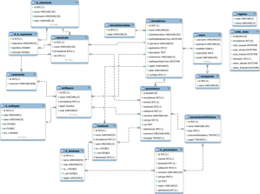
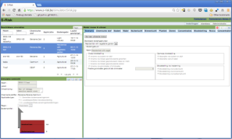


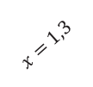






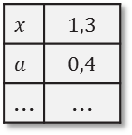




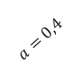

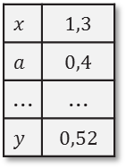
S-Risk application & technical set-up
How does it work technically?
www
vito
web server
WWW
$x=$1,3
database server
browser
$x=$1,3
$a=$0,4
$a=$0,4
$y=$0,52
$x=$1,3
$a=$0,4
$$x$$ | 1,3
$$a$$ | 0,4
... | ...
$$y$$ | 0,52
$$x$$ | 1,3
$$a$$ | 0,4
... | ...
calculation servers
$$y=a×x$$
$=0,4×1,$3
$$=0,52$$
$x=$1,3
$a=$0,4
$$x=$$
1,3
$y=$0,52
$$a=$$
0,4

Slide 5
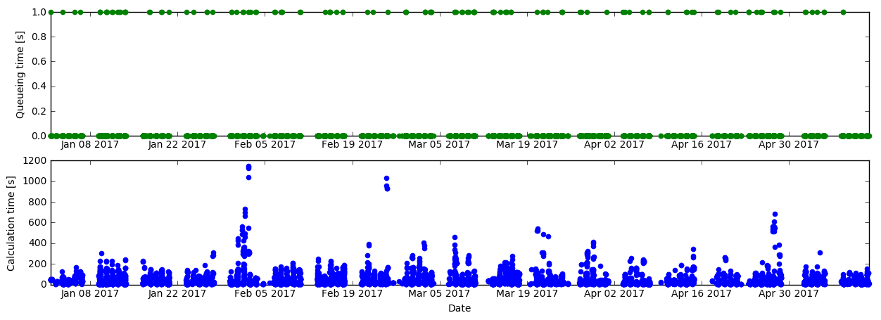
S-Risk application & technical set-up
Some statistics
~90 company licenses → 100 individual accounts
>15 000 simulations (= close to 80 000 simulation runs executed)
Server monitoring: queueing & calculation times:

Slide 6
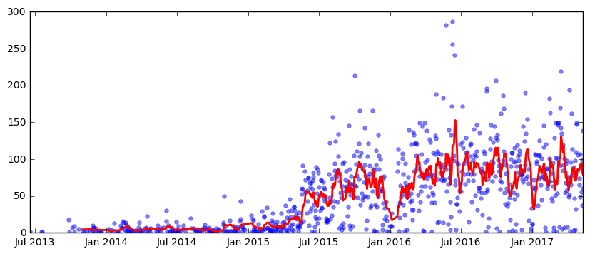
S-Risk application & technical set-up
Some statistics
~90 company licenses – >100 individual accounts
>15 000 simulations (= close to 80 000 simulation runs executed)
Server monitoring: queueing & calculation times
Number of simulations per day:

Slide 7
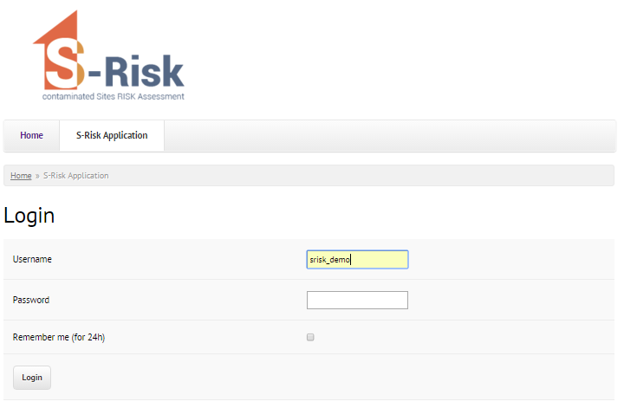
Web portal
... and in practice?
https://www.s-risk.be

Slide 8
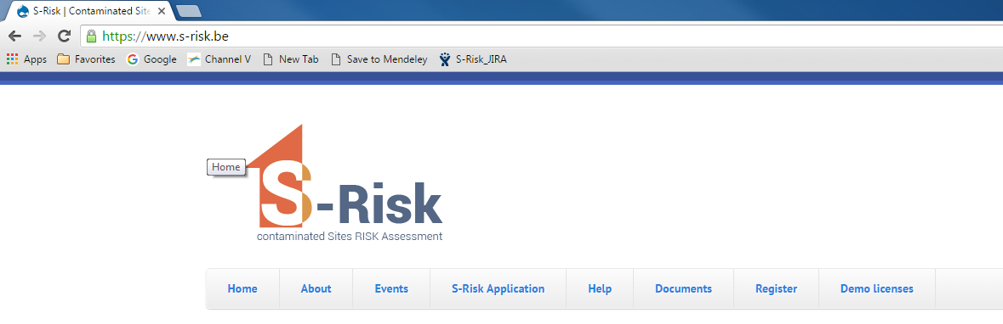
Web portal
The communication channel about S-Risk
http://www.s-risk.be
Home
About
Events
S-Risk Application
Help
Documents
Register
Demo licenses

Slide 9

Web portal
The communication channel about S-Risk
http://www.s-risk.be
Home → updates, news, things you should know
About
Events
S-Risk Application
Help
Documents
Register
Demo licenses

Slide 10

Web portal
The communication channel about S-Risk
http://www.s-risk.be
Home
About → background information on S-Risk
Events
S-Risk Application
Help
Documents
Register
Demo licenses

Slide 11

Web portal
The communication channel about S-Risk
http://www.s-risk.be
Home
About
Events → trainings
S-Risk Application
Help
Documents
Register
Demo licenses

Slide 12

Web portal
The communication channel about S-Risk
http://www.s-risk.be
Home
About
Events
S-Risk Application → access to S-Risk model
Help
Documents
Register
Demo licenses

Slide 13

Web portal
The communication channel about S-Risk
http://www.s-risk.be
Home
About
Events
S-Risk Application
Help → FAQs, release notes, news flashes, helpdesk schedule
Documents
Register
Demo licenses

Slide 14

Web portal
The communication channel about S-Risk
http://www.s-risk.be
Home
About
Events
S-Risk Application
Help
Documents → TGD, user manual & substance data sheets
Register
Demo licenses

Slide 15

Web portal
The communication channel about S-Risk
http://www.s-risk.be
Home
About
Events
S-Risk Application
Help
Documents
Register → account information, license agreement & registration platform
Demo licenses

Slide 16

Web portal
The communication channel about S-Risk
http://www.s-risk.be
Home
About
Events
S-Risk Application
Help
Documents
Register
Demo licenses → 1 month free access, once per company

Slide 17

Web portal
The communication channels of S-Risk
Questions about S-Risk? → contact the S-Risk team via:
  info@s-risk.be
  Online contact form

